Slide 1
Inventory Management
System
Java SE 17 • MySQL 8.0 • Java Swing • MVC + DAO
OOP Project
CMPE-252L
Spring 2026
Muhammad Zaid
University of Engineering and Technology | CMPE-252L
June 2026

Slide 2
Problem Statement
Slide 2
Manual Stock Tracking
No Audit Trail
Error-prone spreadsheets, no real-time visibility
Zero record of who performed what and when
Data Inconsistency
No Security
Sales & purchases tracked separately — no sync
No authentication, no hashing, no access control
No Reporting
Manual compilation — slow, inaccurate, wasteful

Slide 3
Project Objectives
Slide 3
01
Demonstrate all 4 OOP pillars in a real-world application
02
Persistent MySQL storage with JDBC PreparedStatements
03
File Handling — timestamped audit log + inventory report
04
Security: SHA-256 hashing, RBAC, SQL injection prevention
05
Live dashboard with KPI cards and Java2D sales bar chart
06
CSV export and printable inventory report generation

Slide 4
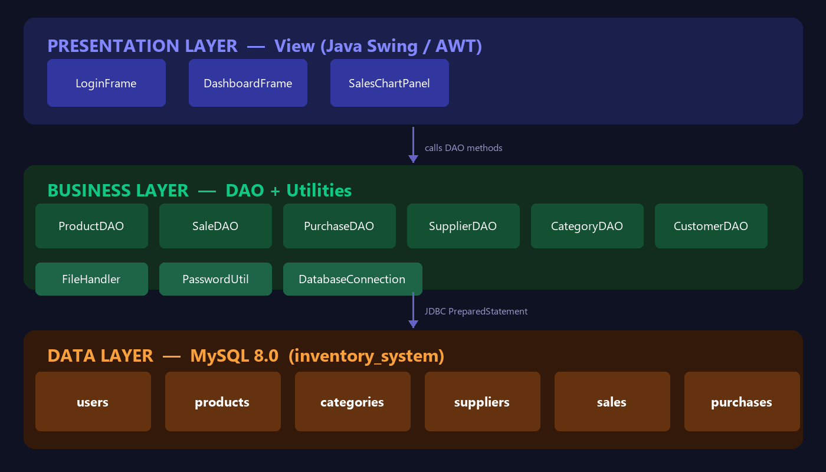
System Architecture — MVC + DAO
Slide 4

Slide 5
OOP Pillars — Applied in This Project
Slide 5
ENCAPSULATION
ABSTRACTION
INHERITANCE
POLYMORPHISM
WHERE:
WHERE:
WHERE:
WHERE:
Product, Sale, Purchase Supplier, Category, User
DAO Layer DatabaseConnection
DashboardFrame extends JFrame SalesChartPanel extends JPanel
SwingWorker ActionListeners Method overloading
HOW:
HOW:
HOW:
HOW:
private fields public getters/setters no direct field access
GUI never sees SQL Calls getAllProducts() Returns Java objects
Inherits full Swing behaviour + custom logic on top
Runtime: paintComponent doInBackground() override Compile: showMsg()

Slide 6
Database Design & File Handling
Slide 6
MySQL 8.0 Database
FileHandler.java — File Handling
users
Login credentials + role (ADMIN/USER)
system_logs.txt
APPEND
Timestamped audit log of every user action in the system
products
Catalogue — price, qty, category, supplier
categories
Product category names
inventory_report.txt
WRITE
Formatted product snapshot exported on demand
suppliers
Supplier name + contact details
sales
Outgoing transactions + soldBy user
data.csv
EXPORT
Any table exported to .csv compatible with Excel
purchases
Incoming stock + addedBy user

Slide 7
Security Implementation
Slide 7
SHA-256 Password Hashing
SQL Injection Prevention
Passwords hashed with Java's MessageDigest API. Never stored in plain text — DB only holds the hash.
All queries use JDBC PreparedStatements. User input never concatenated into SQL strings.
Role-Based Access Control
Credential Management
ADMIN: full CRUD on all modules. USER: read-only, restricted access to sensitive tabs.
DB credentials stored in config.properties. Excluded from git via .gitignore — never hardcoded.

Slide 8
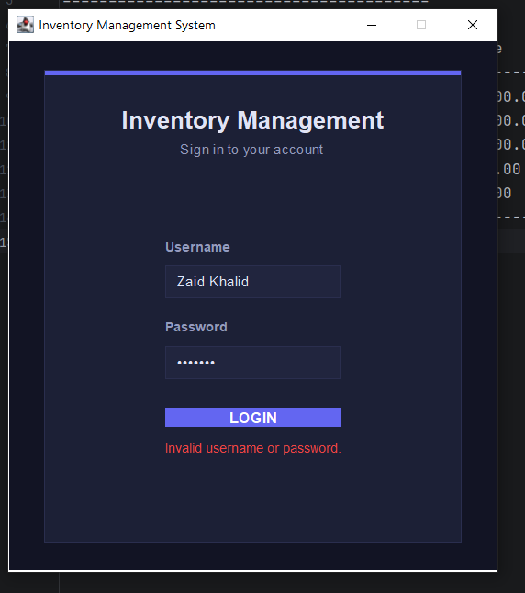
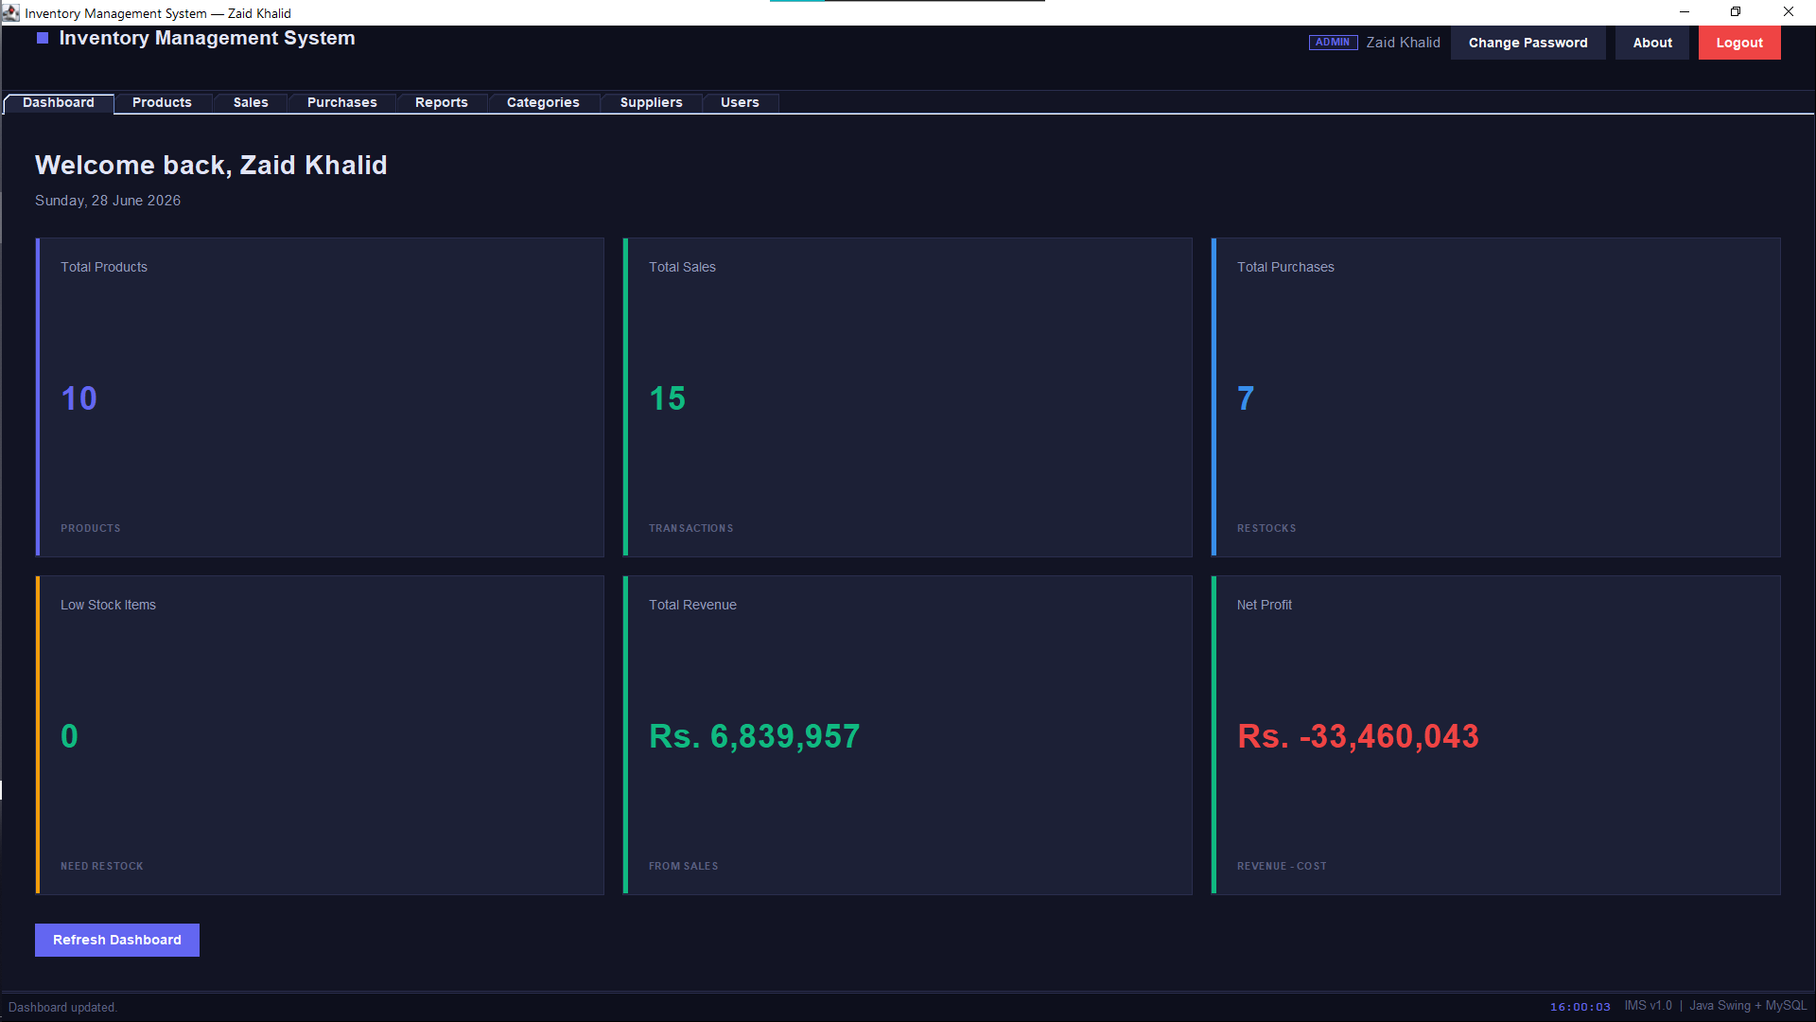
System Demo — Login & Dashboard
LIVE OUTPUT
Slide 8
Login — SHA-256 Authentication
Dashboard — Live KPI Cards

Slide 9
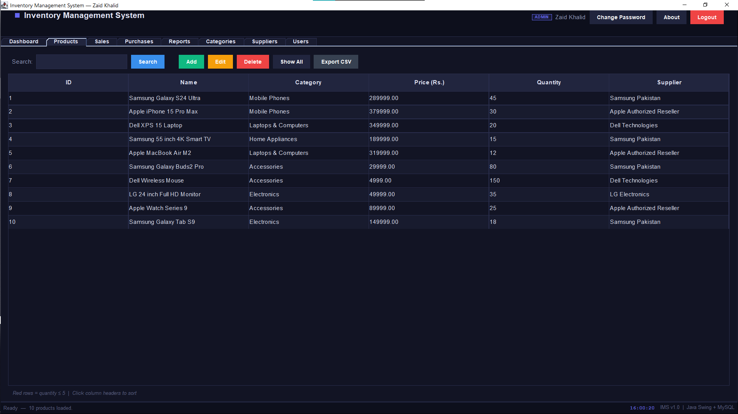
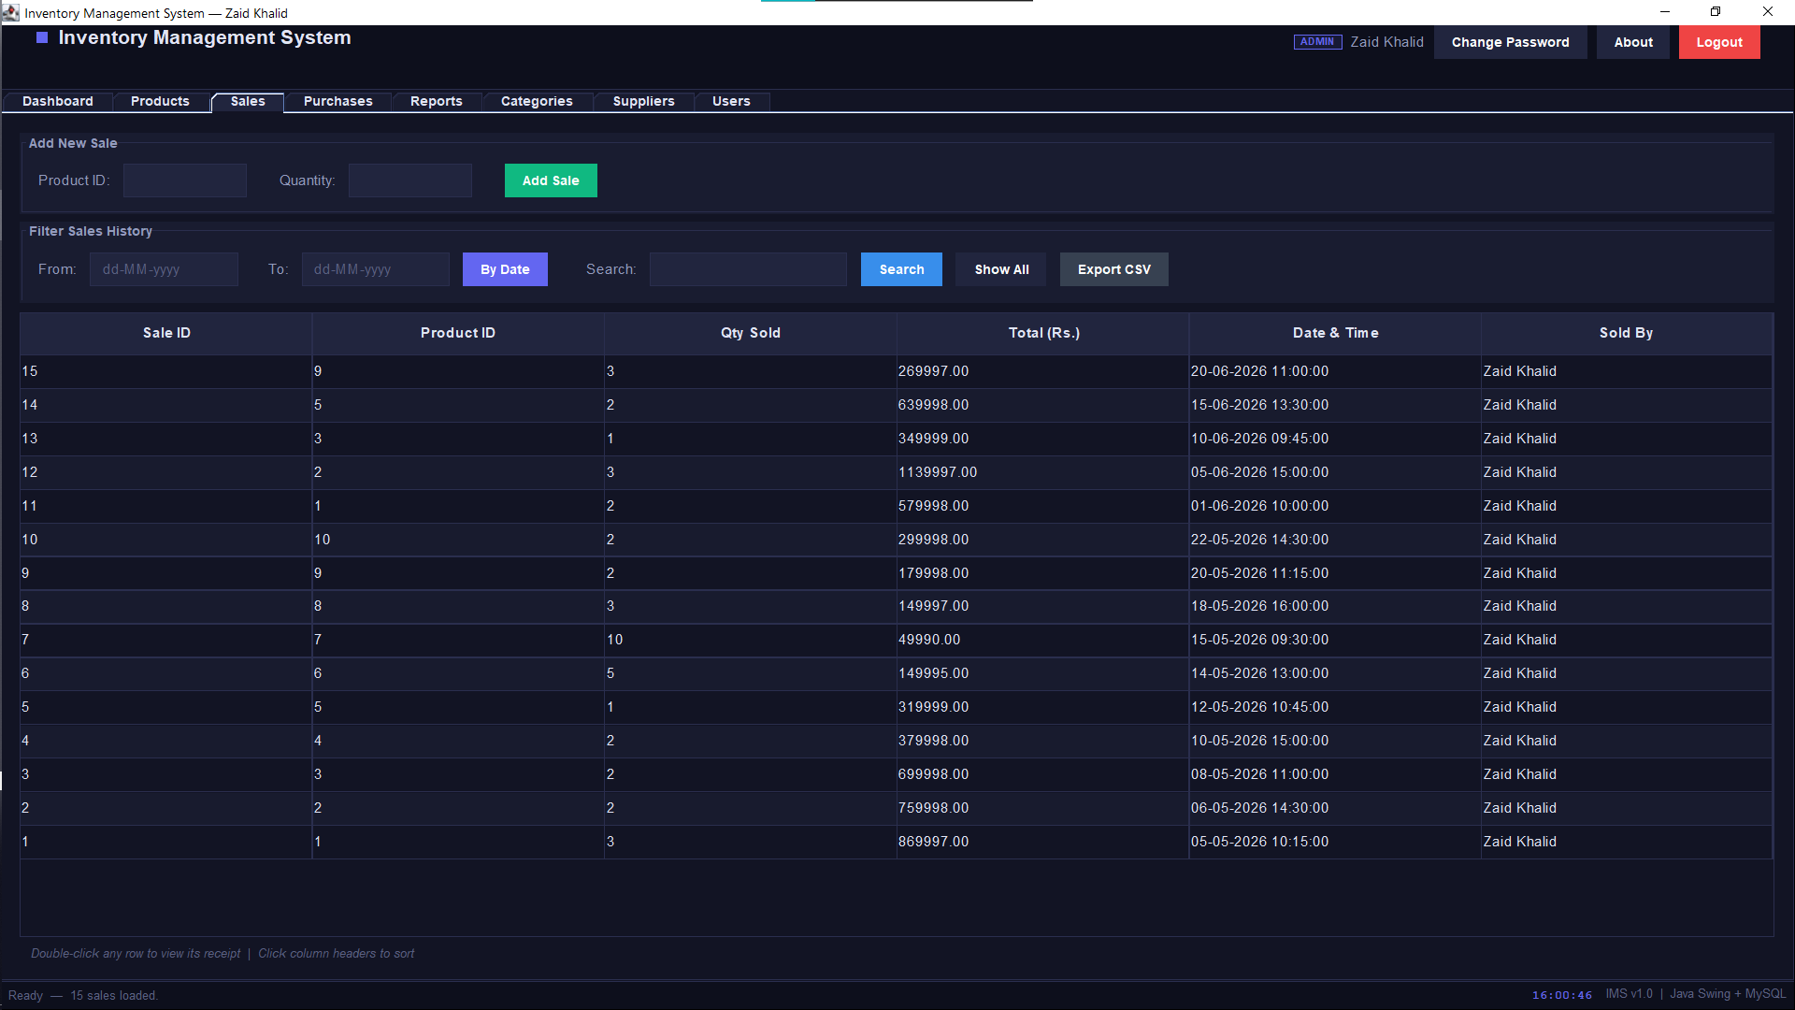
System Demo — Products & Sales
LIVE OUTPUT
Slide 9
Products — Add / Edit / Delete / Search
Sales — Transactions with Stock Decrement

Slide 10
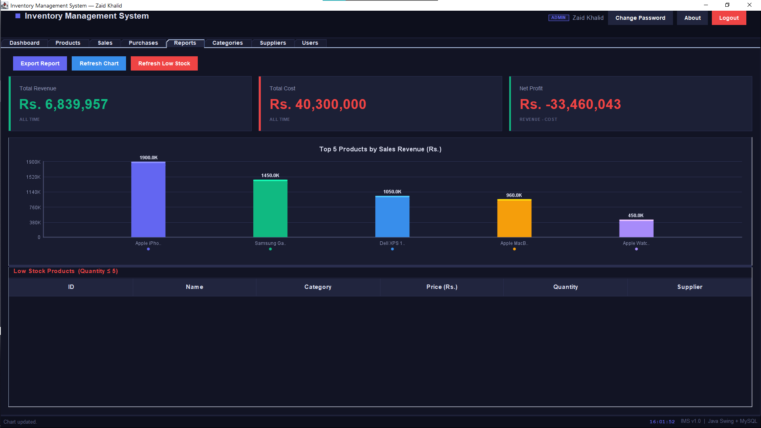
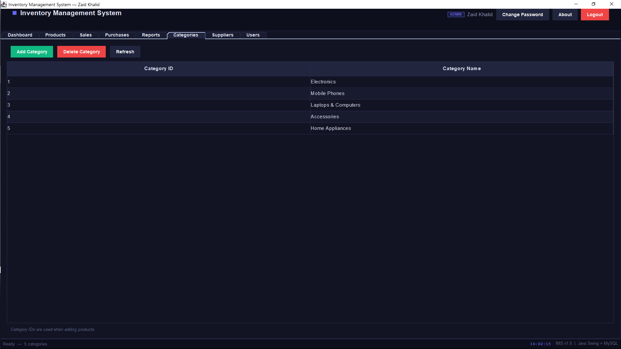
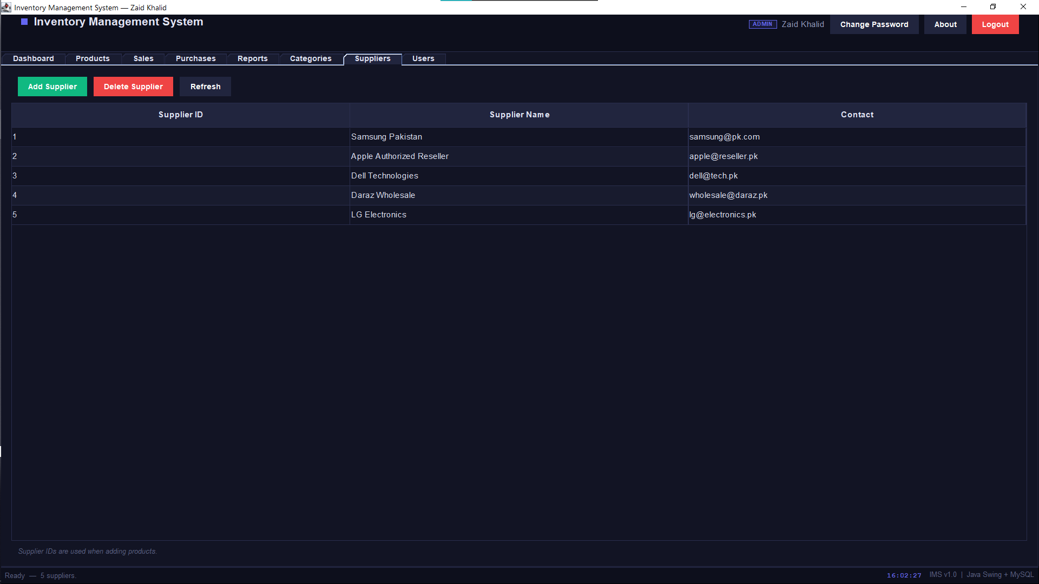
System Demo — Reports & Data Management
LIVE OUTPUT
Slide 10
Analytics — Top 5 Bar Chart + Revenue Summary
Categories
Suppliers

Slide 11
Testing Results
Slide 11
Test Case
Expected Result
✓
Login with valid credentials
Dashboard opens correctly
✓
Login with wrong password
Error dialog displayed
✓
Add product with all fields
Product appears in table instantly
✓
Add sale — sufficient stock
Sale recorded, stock decremented
✓
Add sale — insufficient stock
Error shown, no sale created
✓
Delete category linked to product
Deletion blocked with message
✓
Export CSV
File saved at chosen path
✓
Export Inventory Report
inventory_report.txt updated
✓
Audit log verification
Every action logged with timestamp
✓
Role restriction (USER role)
Admin-only tabs hidden
✓
10 / 10 Passed ✓

Slide 12
Conclusion
All 4 OOP pillars concretely applied — not just defined.
Future Work
REST API backend
MySQL 8.0 integration via JDBC PreparedStatements — no raw SQL.
PDF invoice generation
File handling — audit log & inventory report via FileWriter API.
Barcode scanner
Security: SHA-256 hashing, RBAC, PreparedStatement injection prevention.
Email alerts
10/10 functional test cases passed — system is production-ready.
JUnit 5 test suite
Thank You — Questions Welcome
Muhammad Zaid | University of Engineering and Technology | CMPE-252L

